Slide 1
Учеба студентов МЭИ за рубежом
Константин Александрович Орлов

Slide 2
Образование за рубежом
1. Сотрудничество с Фондом им. проф. Ридле
2. Программы двух дипломов:
MPEI-Glyndŵr
MPEI-WUST
MPEI-LUT

Slide 3
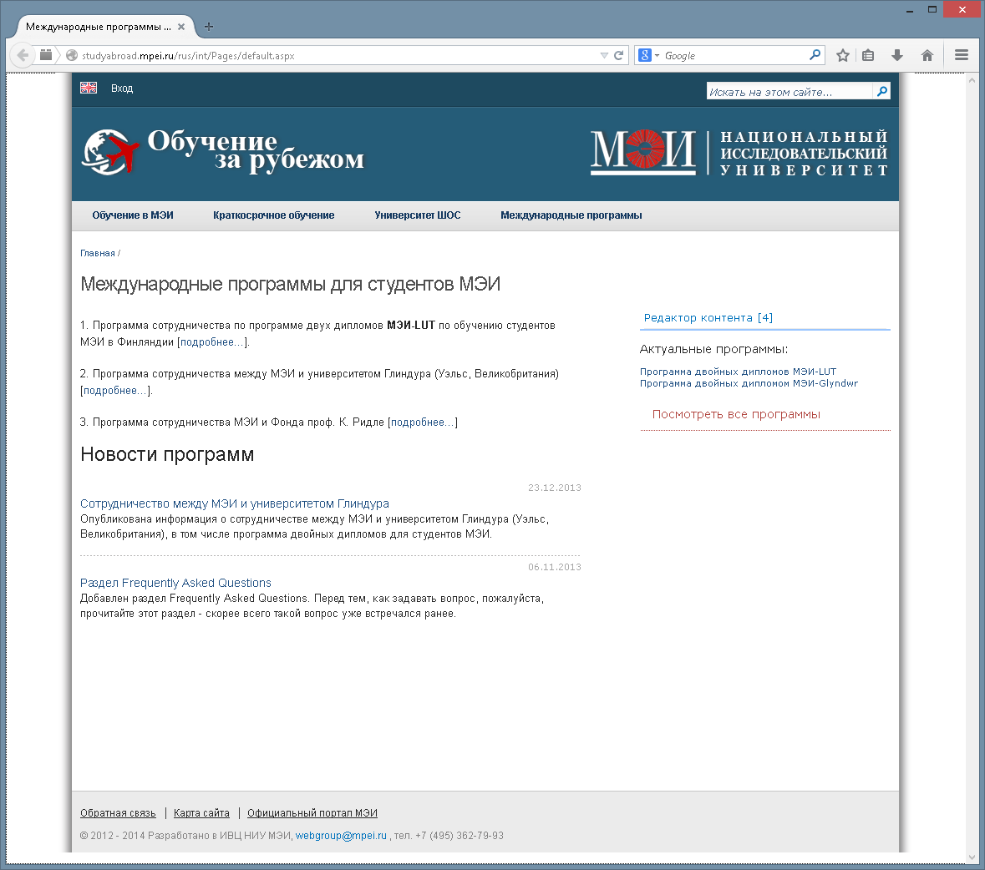
http://
STUDYABROAD.MPEI.RU

Slide 4
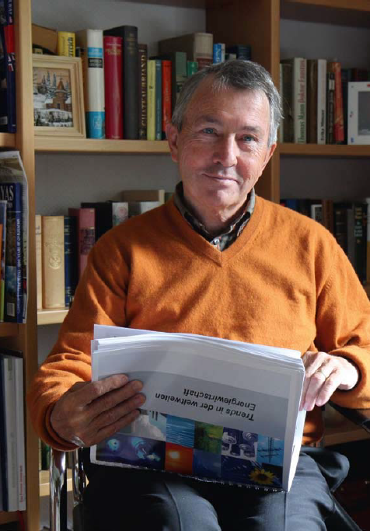
ФОНД ИМ. ПРОФ. КЛАУСА РИДЛЕ

Slide 5
Проф. Клаус Ридле
Бывший глава дивизиона «Gas Turbines and Econopacs» подразделения «Siemens Power Generation»
Лауреат премии «Глобальная энергия»’2005
В 2005 из его личных средств на базе университета Фридриха–Александра (ФАУ) (г. г. Эрланген–Нюрнберг, Германия) был создан Фонд им. проф. Ридле
В 2006 переговоры в МЭИ с участием д-ра М. Гитцельса («Сименс»): использование стипендий Фонда К. Ридле для студентов и аспирантов МЭИ

Slide 6
Сотрудничество с Фондом им. проф. Клауса Ридле
Стипендии на выполнении УНИР в МЭИ
Гранты на 6-месячную стажировку в Германии

Slide 7
Стипендии Фонда им. проф. Ридле
Учеба в МЭИ
Весенний семестр 5-го курса
Большинство стипендиатов получает в дальнейшем грант на 6-месячную учебу в Германии
Для студентов ИТАЭ, каф. ПГТ, каф. ТМПУ

Slide 8
Гранты Фонда им. проф. Ридле
Учеба в Университете Фридриха-Александра (ФАУ), г. Эрланген и г. Нюрнберг, Германия
Обучение с октября по март (6-й год обучения)
Для студентов 5-го курса: ИТАЭ, каф. ПГТ, каф. ТМПУ

Slide 9
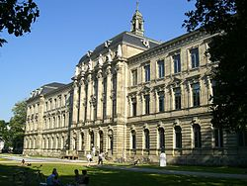
Подача заявки по программам Фонда им. проф. Ридле
Заполни анкету на русском и английском языках (studyadroad.mpei.ru)
Выслать анкету на email: OrlovKA@mpei.ru
Срок: до конца декабря

Slide 10
Double MASTER degree program
MPEI-Glyndŵr (Great Britain)

Slide 11
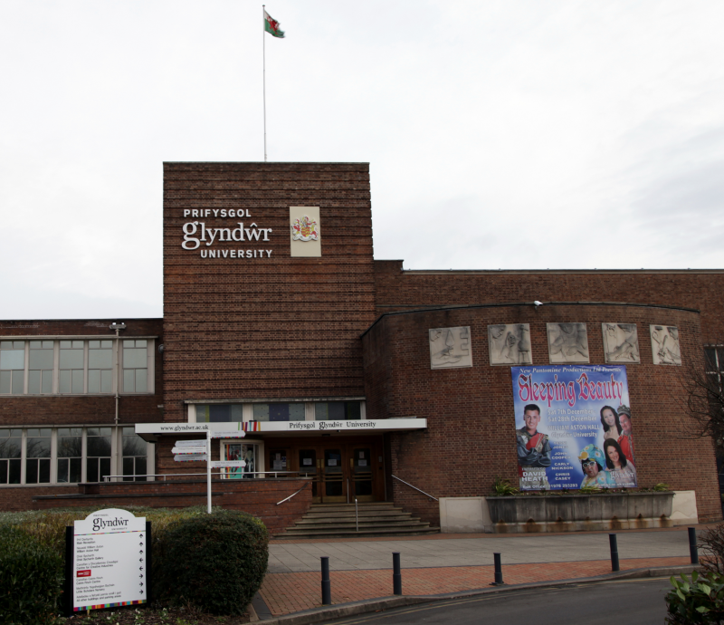
Glyndŵr University
Great Britain
North-east part of Wales
Wrexham
8000 students

Slide 12
MSc in Computer Science
60 UK credits from MPEI
60 UK credits will be delivered at 6 week MSc Summer School which will be held on June-July 2017
MSc dissertation will be conducted at MPEI under Glyndwr University staff supervision
ILETS 6.5
The cost of the programme is 3000GBP: - tuition fee - student accommodation for 6 weeks - transfer from and to airport - a cultural trip (a bus trip across North Wales)

Slide 13
Who can apply?
5-year students of AVTI
5-year students from other Institutes who studied courses (modules) in the areas of Computer Science

Slide 14
Summer school
Glyndŵr University

Slide 15
Glyndŵr University: Summer school
August 2017
Engineering and Computing courses (Mechanical Engineering, Electrical Engineering, Computer Science etc.)
The cost is about 1000GBP (including 4-week accommodation)
Certificate on English (MPEI): Reading, Writing, Speaking and Listening

Slide 16
Wroclaw university of Science and technology (WUST)
Double degree program

Slide 17
WUST
Wroclaw (Poland)
1st student apply for this program this year
2nd year of Master study will be done in WUST

Slide 18
English language requirements
TOEFL – 87 points iBT
TOEFL –180 points CBT plus 50 points TSE
TOEFL –150 points PBT plus 3.5 points in TWE plus 50 points in TSE
Test of English for International Communication (TOEIC) – 700 points

Slide 19
WUST: Double degree program
Refrigeration and Cryogenics
Renewable Sources of Energy
Advanced Informatics and Control
Internet Engineering
Control in Electrical Power Engineering
Renewable Energy Systems
Production Management

Slide 20
Finances
About 600 Euro/month is required
Erasmus+ scholarship

Slide 21
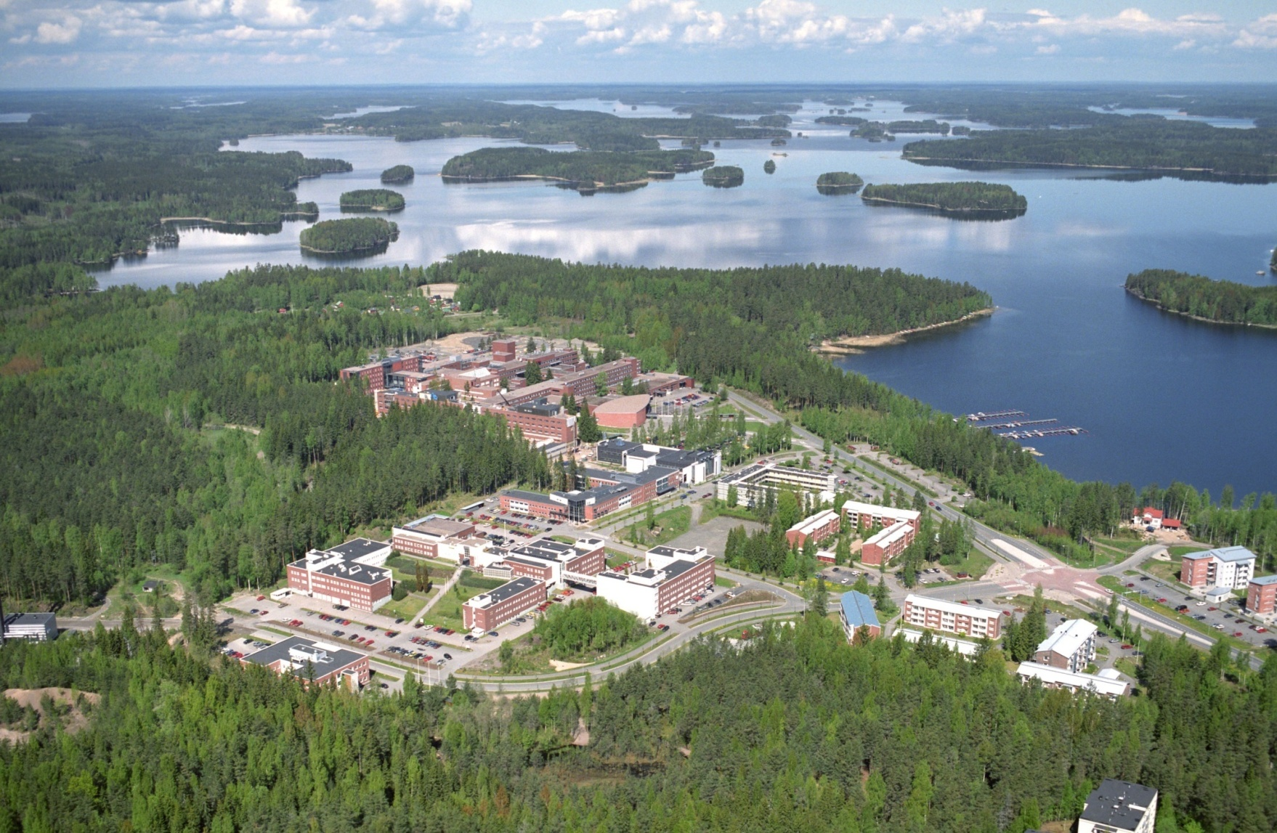
Lappeenranta University of Technology
Double degree programs

Slide 22
MPEI-LUT Double degree programs
Master degree program
All students from MPEI
10 month study in LUT
At the end – two diplomas: MPEI and LUT

Slide 23
List of specialties in LUT
ELECTRICAL ENGINEERING:
Solar Economy
Industrial Electronics
ENERGY SYSTEMS:
Bio-Energy Systems
Nuclear Engineering
MECHANICAL ENGINEERING:
Mechatronic System Design
Welded Metal Structures
Sustainable Production in Mechanical Engineering
SUSTAINABILITY SCIENCE AND SOLUTIONS

Slide 24
Timetable #1
October: 1st year Master degree student apply for program in MPEI
End of November: Preliminary approval of candidates in MPEI
December: LUT’s Professors visit to MPEI for interview
December-28th of February: Application on LUT website

Slide 25
Timetable #2
May: results from LUT
June: Preparing documents in MPEI, visa, LUT
July: LUT summer school
August: introduction week in LUT
September-May: study at LUT
June: presenting diploma project in MPEI
June: diploma from LUT

Slide 26
MPEI-LUT
LUT is ready to admit about 50 students from 50 each year
About 10-15 students apply each year
Why?

Slide 27
Challenges for students
Motivation
Choosing proper specialty in LUT
English language skill
Financial questions

Slide 28
Motivation
10 months study at European University
Significantly improving of English language skills
Two diplomas
Possibility to find work in Finland company (practice)
More easy to apply for working in international company after graduation
Last but not least: open the mind

Slide 29
English language skills
Academic TOEFL 65 iBT or 513 PBT
Academic IELTS 5.5
PTE Academic 46
Cambridge English CAE/CPE level C

Slide 30
Financial questions
Tuition fee: 10000 Euro
Living expenses: 5000 Euro
English test fee, fee for visa, travelling, translation of the official documents: ~1000 Euro

Slide 31
Scholarship from LUT
Full Scholarship
covering for the tuition fee and the living expenses
Tuition Fee Scholarship
covering for 100 % of the tuition fee
Tuition Fee Scholarship
covering for 50 % of the tuition fee
Offered based on academic excellence!

Slide 32
Lappeenranta University of Technology
Winter and Summer Schools

Slide 33
Winter and Summer Schools in LUT
Summer: 17 July - 11 August 2017
Fees for partner university students tuition fee: for 3-4 weeks 795 EUR / for 2 weeks 595 EUR. The tuition fee includes course material, lunch and social activities.
Accommodation: for 3–4 weeks 500 EUR / for 2 weeks 400 EUR.
Winter: 9 January - 3 March 2017

Slide 34
http://
STUDYABROAD.MPEI.RU

Slide 35
Thank you for your attention!
Konstantin Orlov, MPEI OrlovKA@mpei.ru
Any questions?

